Slide 1
Austin Bike Sharing
Solving Austin’s Biggest Problem
Henry Chang | Vir Mehta Akhil Reddy | Rachel Rong

Slide 2

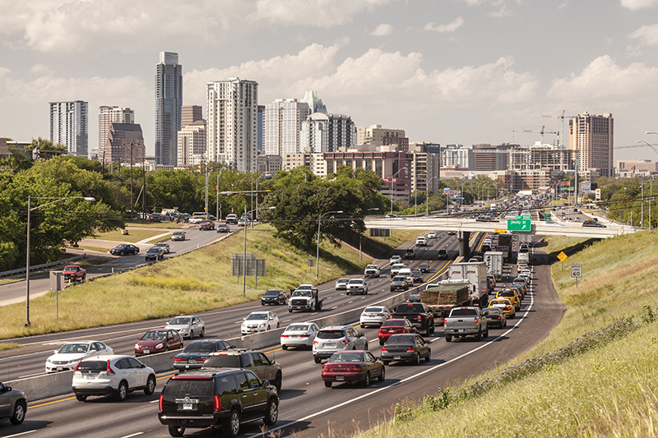


1
Objective
2
Approach
.
3
EDA
.
4
Insights

Slide 3
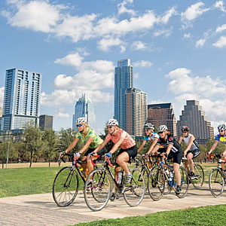
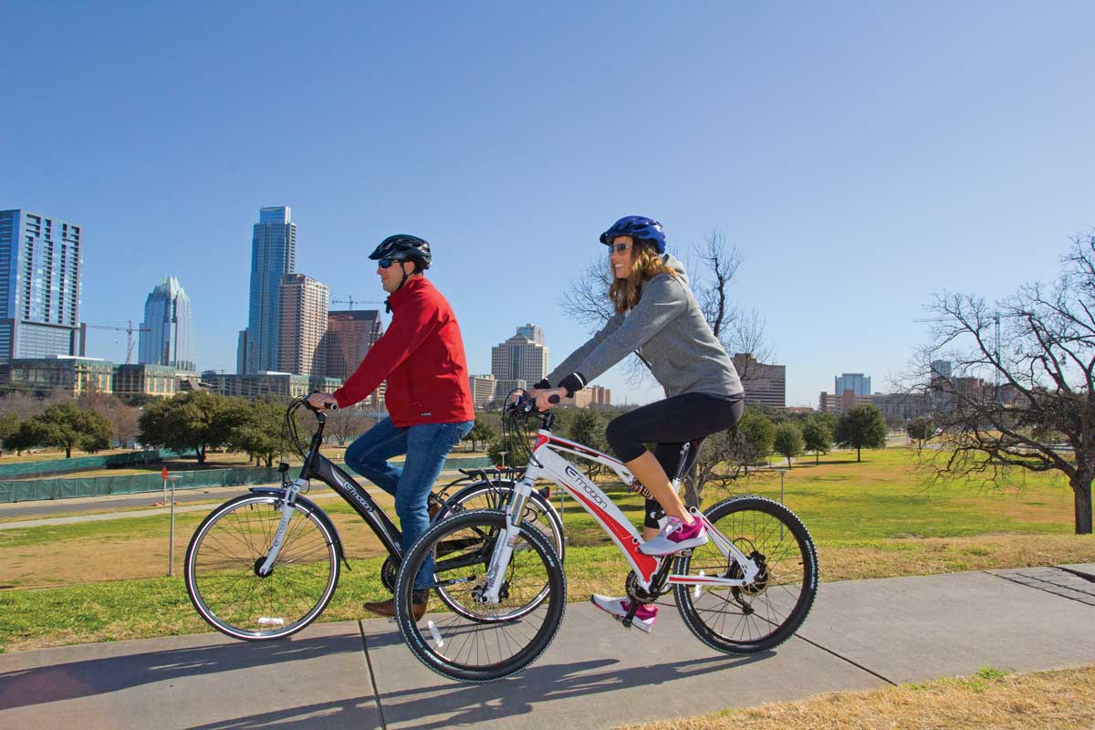
Objectives & Hopeful Outcomes
Objective
Efficient Allocation of Bikes
Willingness to Try
Less Cars on Roads
Health Benefits
Outcomes

Slide 4





Exploratory Data Analysis
Location
Membership
Time
Weather
Demographics
Location of Bike Stations
Rides per Station
Fastest Growing Stations
Identify Type of Bike Share User
Local30 / Local 365 Programs
Seasonality
Spikes in Demand
Days of the Week
Time of Day
SXSW & ACL
‘Too Hot’ & ‘Too Cold’ Temperatures
Impact of a Rainy Day on Demand
Based on Zip Codes of Stations
Residents that ‘Walk to Work’
Residents between ‘Ages 15 & 24’

Slide 5
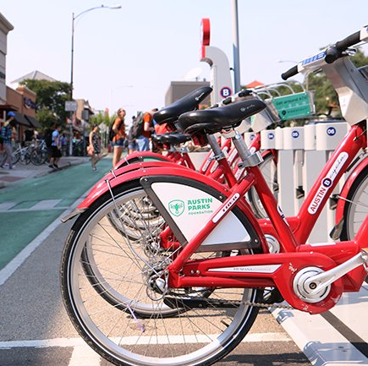
Location
Most Popular Stations
Station Name | Number of Rides | Annual Growth
Riverside @ S. Lamar | 8906 | 23%
Rainey St @ Cummings | 7684 | 12%
City Hall / Lavaca & 2nd | 7277 | -6%
2nd & Congress | 7265 | -12%
5th & Bowie | 6780 | -15%
Davis at Rainey Street | 6679 | 46%
Zilker Park | 6315 | -16%
4th & Congress | 6261 | 4%
Convention Center / 4th St. @ MetroRail | 6260 | 4%
Pfluger Bridge @ W 2nd Street | 6131 | 23%
Note: 2016 data has been considered to identify the busiest stations

Slide 6
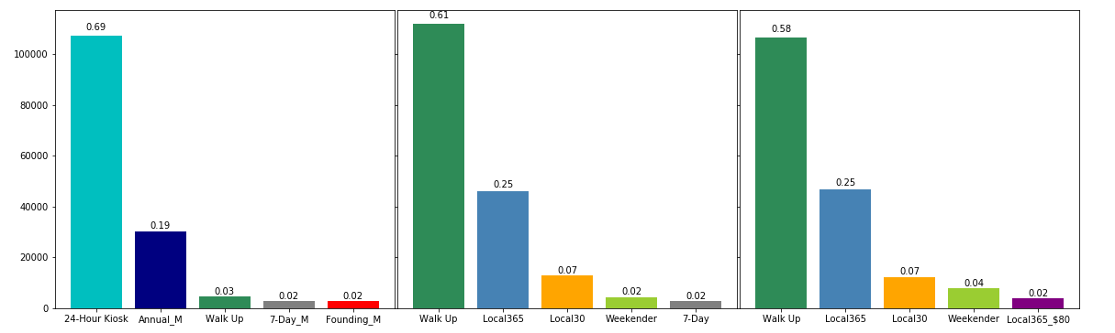
Membership
Types of Users
2014
2015
2016
Note: 24-hour Kiosk category has been dissolved since 2015

Slide 7
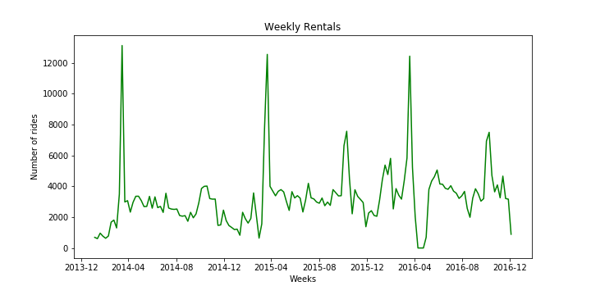
Time
Spikes in Rides during March & October
Note: Data from 2015 and 2016 is considered for analyzing the hourly trends

Slide 8
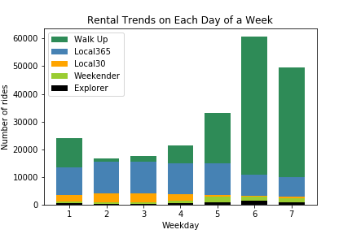
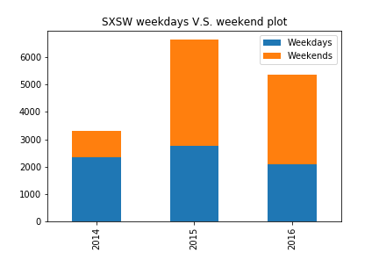
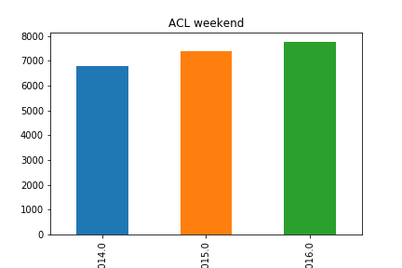
Time
Day of the Week (Including SXSW & ACL)
Note: 24-hour Kiosk category has been dissolved since 2015

Slide 9
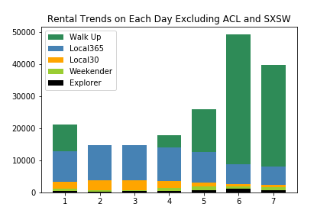
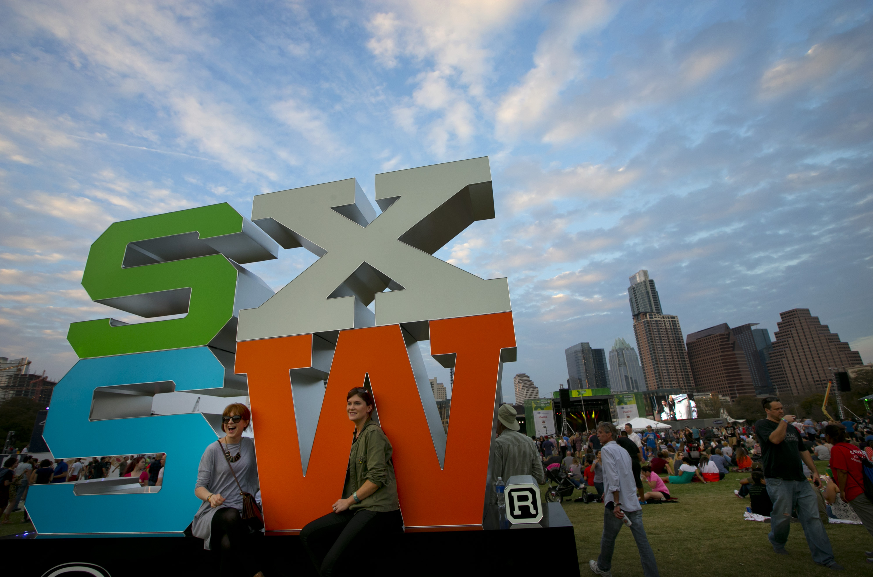
Time
Day of the Week (Not Including SXSW & ACL)
Note: 24-hour Kiosk category has been dissolved since 2015

Slide 10
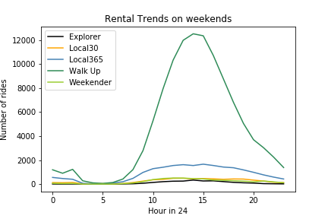
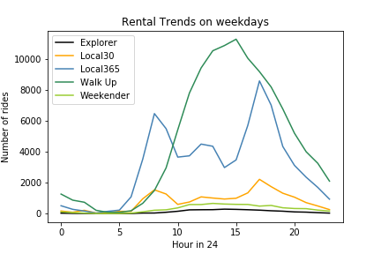
Time
Time of Day
Note: Data from 2015 and 2016 is considered for analyzing the hourly trends

Slide 11
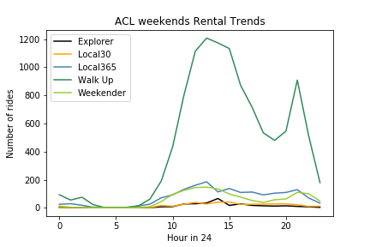

Time
Trends During ACL
Note: Data from 2015 and 2016 is considered for analyzing the hourly trends

Slide 12



Weather
Impact of Weather on Bike Sharing
Rainy Days
Hot Days
Cold Days
% Drop in Rides
67%
36%
72%
Note: Cold days : <60F, Hot days: >80F

Slide 13

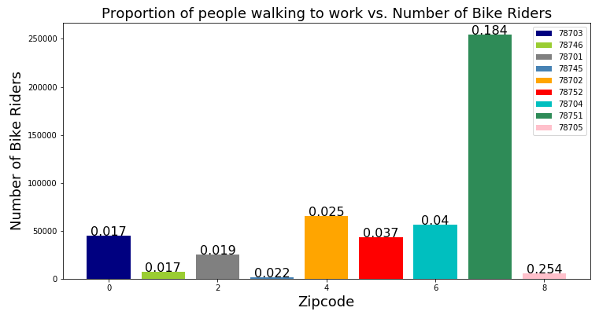
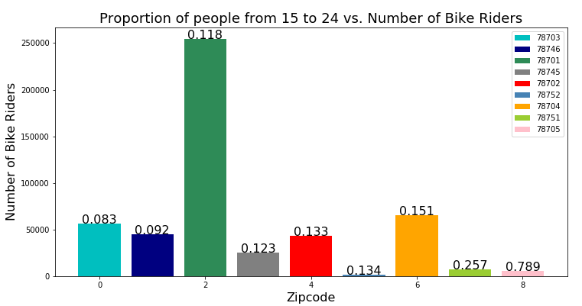
Demographics
Demographic Factor
Note: 24-hour Kiosk category has been dissolved since 2015

